Slide 1

Project Title:
Intelligent Inventory Management System
By Sasank Ega

Slide 2
Introduction
“An Intelligent Inventory Management System (IIMS) is a software application that helps companies track, analyze, and manage stock in a smart and automated way.”
“Intelligent Inventory Management System is an automated software that tracks stock levels, predicts demand, avoids shortages, and helps organizations maintain the right amount of inventory at the right time.”

Slide 3
Aim and Uses of the System
Aim: This project aims to create a system that intelligently manages inventory, optimizing stock levels, reducing waste, and improving overall efficiency through automation and data-driven insights.
Uses:
1.Optimized Stock Levels: Prevents overstocking and stockouts, minimizing holding costs and lost sales.
2.Automated Ordering: Automatically generates purchase orders when stock levels fall below predefined thresholds.
3.Real-time Visibility: Provides a clear, up-to-date view of inventory levels across all locations.
4.Demand Forecasting: Predicts future demand based on historical data, seasonality, and other factors.
5.Reduced Waste: Minimizes spoilage, obsolescence, and other forms of inventory loss.
6.Improved Efficiency: Streamlines inventory management processes, freeing up staff time for other tasks
7.Reduces Human Errors : human errors
Example : medical shop /pharma industry

Slide 4

Problems in Existing System:
Manual Data Entry → High Human Errors
Traditional systems depend on pen-paper or Excel sheets.
Common errors:
•Wrong quantity entered
•Items not updated after sale
Mistyped product codes
No Real-Time Stock Tracking
Managers do not know:
•Current stock
•Items that are almost finished
•Fast-moving or slow-moving products
This leads to:
•Out-of-stock situations
•Manual errors
•No real-time updates
•No forecasting
•Late reordering
•Stockouts & overstock
•High wastage
•No expiry tracking
•Time-consuming
•Poor data security
•No alerts
No Automated Alerts
Manual systems do not give:
•Low-stock alerts
•Expiry alerts
•Purchase reminders
Managers must check everything manually
Poor Inventory Visibility Across Locations
If a business has multiple branches:
•No centralized system
•One branch doesn’t know stock of another
This causes delays and confusion

Slide 5
Proposed Statement:
Automated Inventory Tracking: Real-time monitoring of stock levels
Automated Ordering: Automatically generates purchase orders when stock levels fall below predefined thresholds.
•Alerts and Notifications: Sends alerts when stock levels are low, products are expiring, or other critical events occur.
•Comprehensive Reporting: Provides detailed reports on inventory levels, sales trends, and other key metrics.

Slide 6
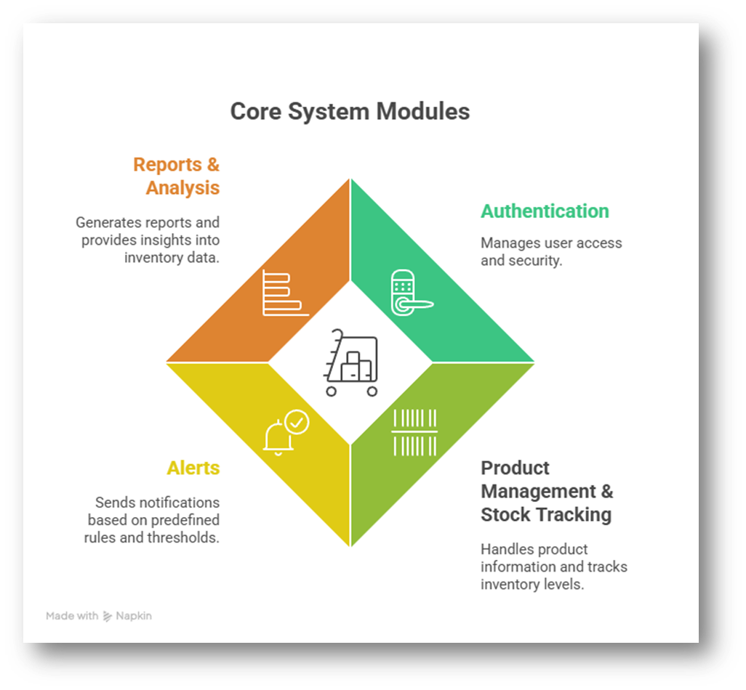
System Modules
The Intelligent Inventory Management System consists of four key modules:
1.Authentication: Manages user access and security.
2.Product Management & Stock Tracking: Handles product information and tracks inventory levels.
3.Alerts: Sends notifications based on predefined rules and thresholds.
4.Reports & Analysis: Generates reports and provides insights into inventory data.

Slide 7
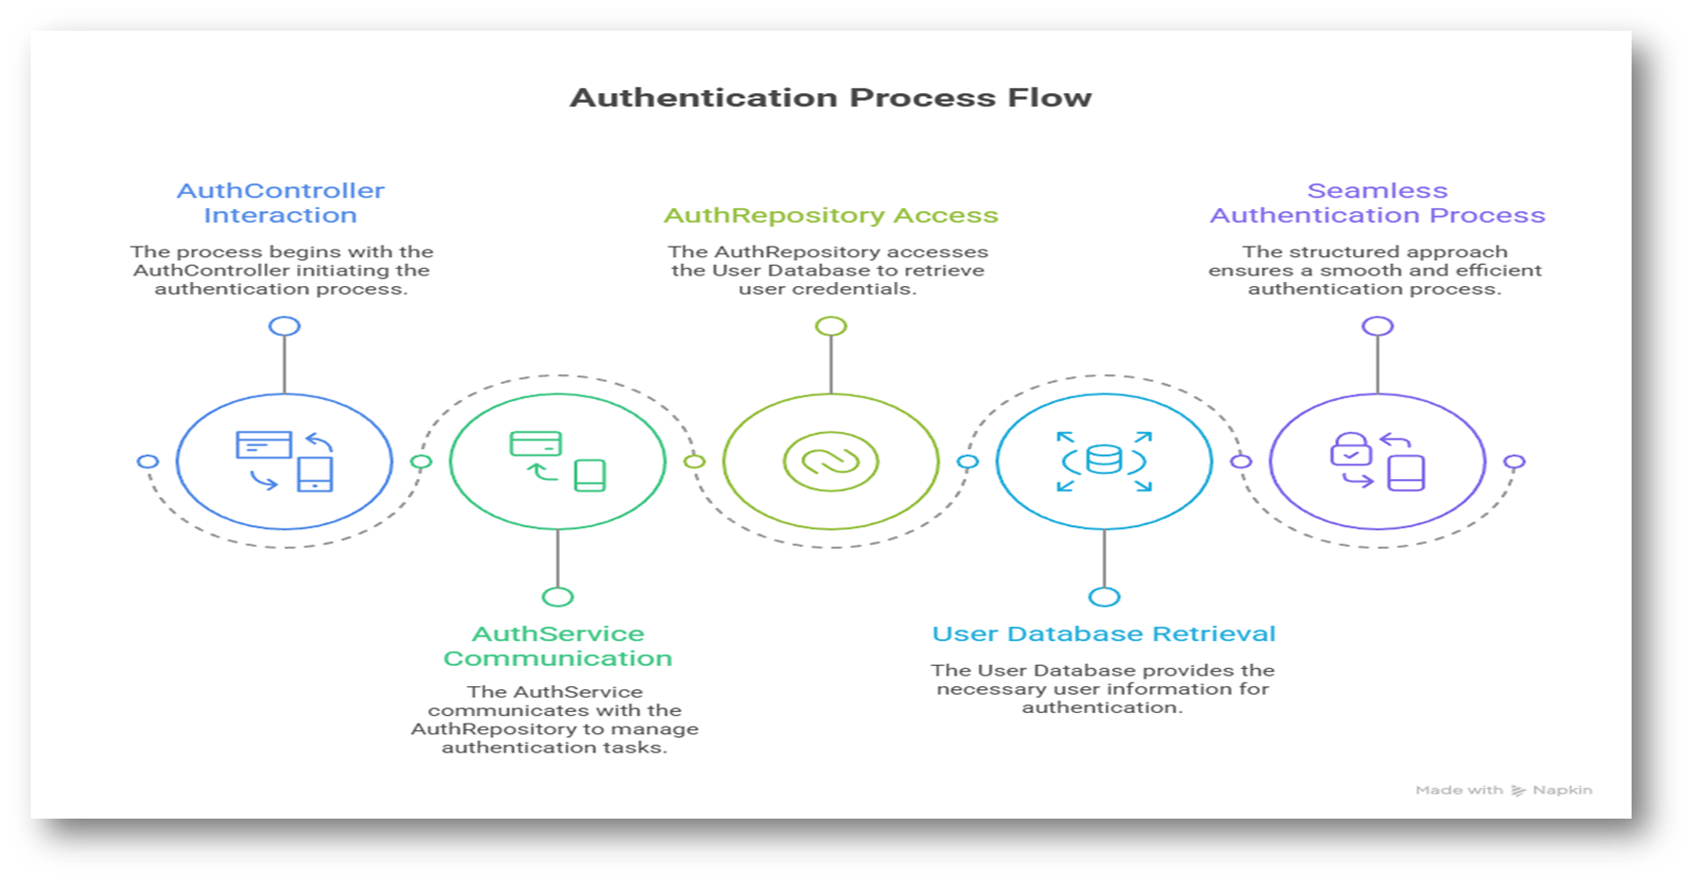
Module Working Process
Module 1:

Slide 8
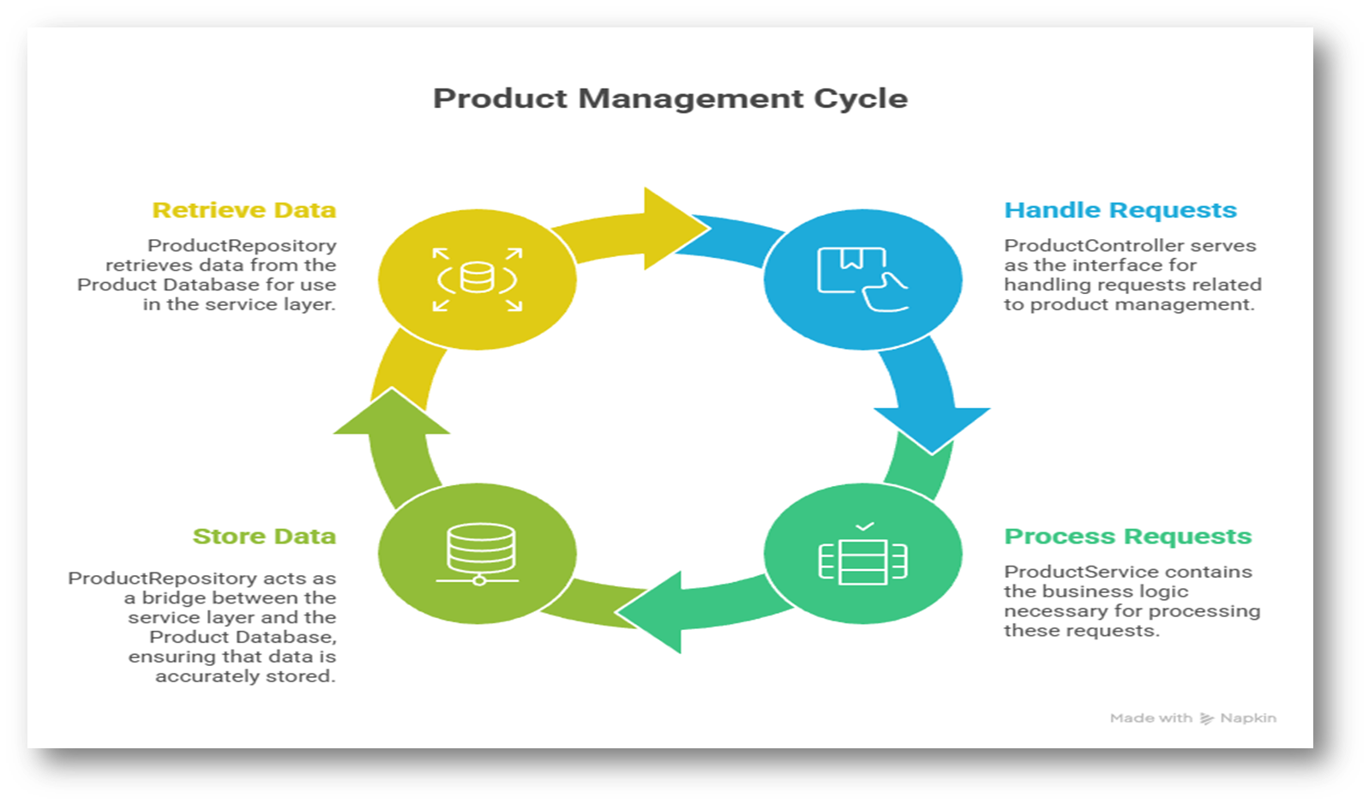
Module 2:

Slide 9
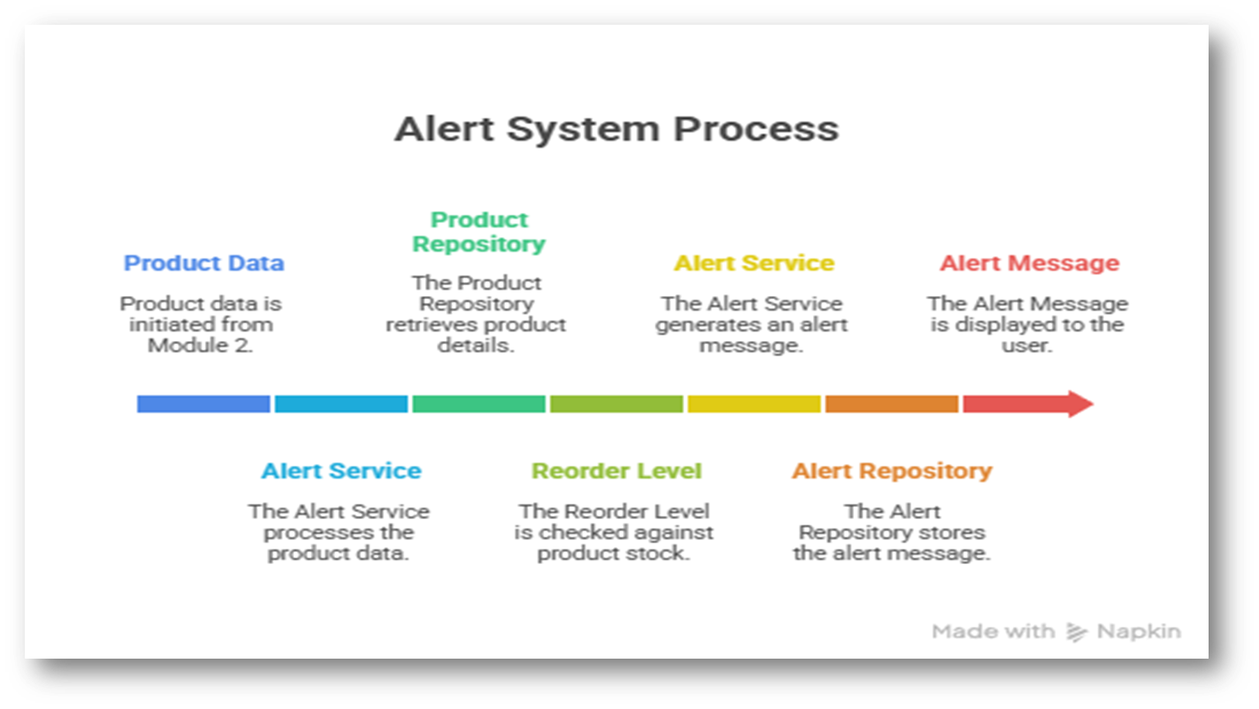
Module 3:

Slide 10
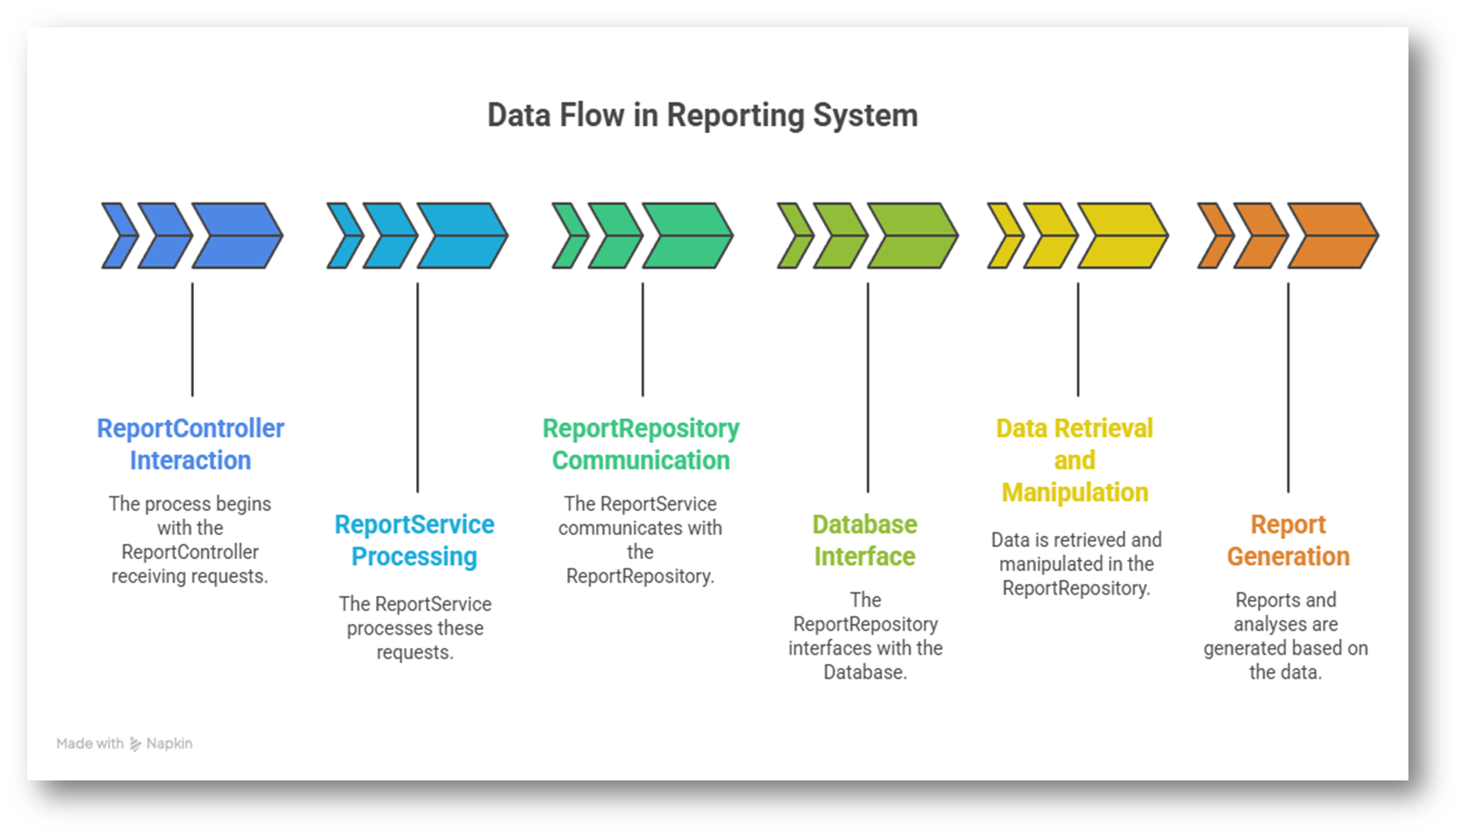
Module 4:
Reports & Analysis

Slide 11
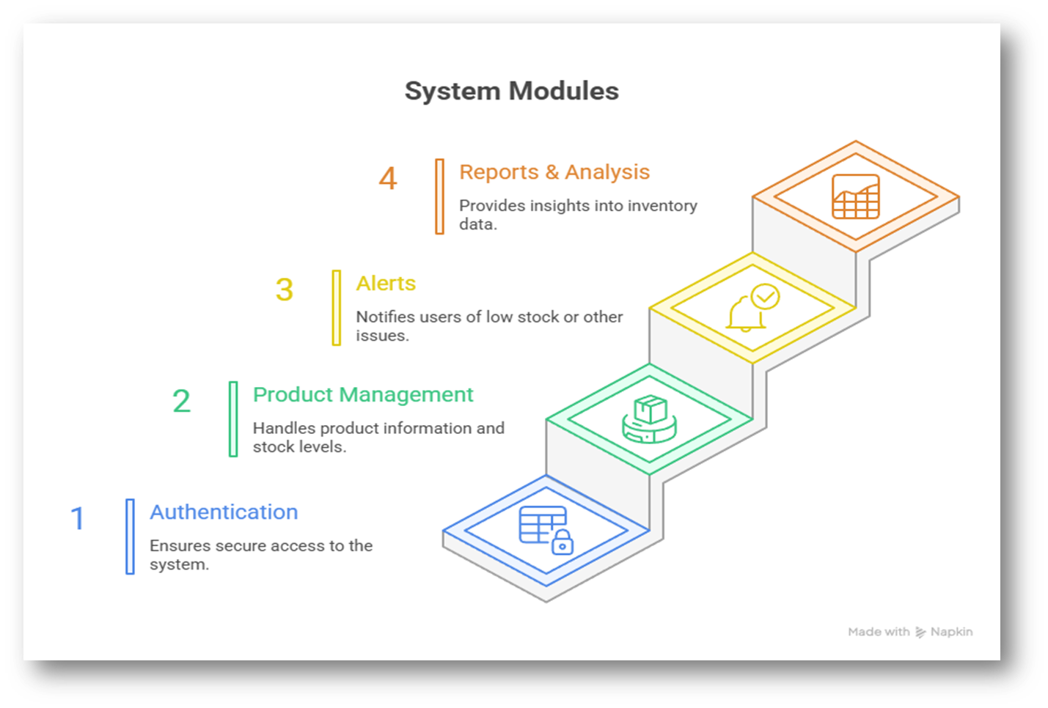
System Module:

Slide 12
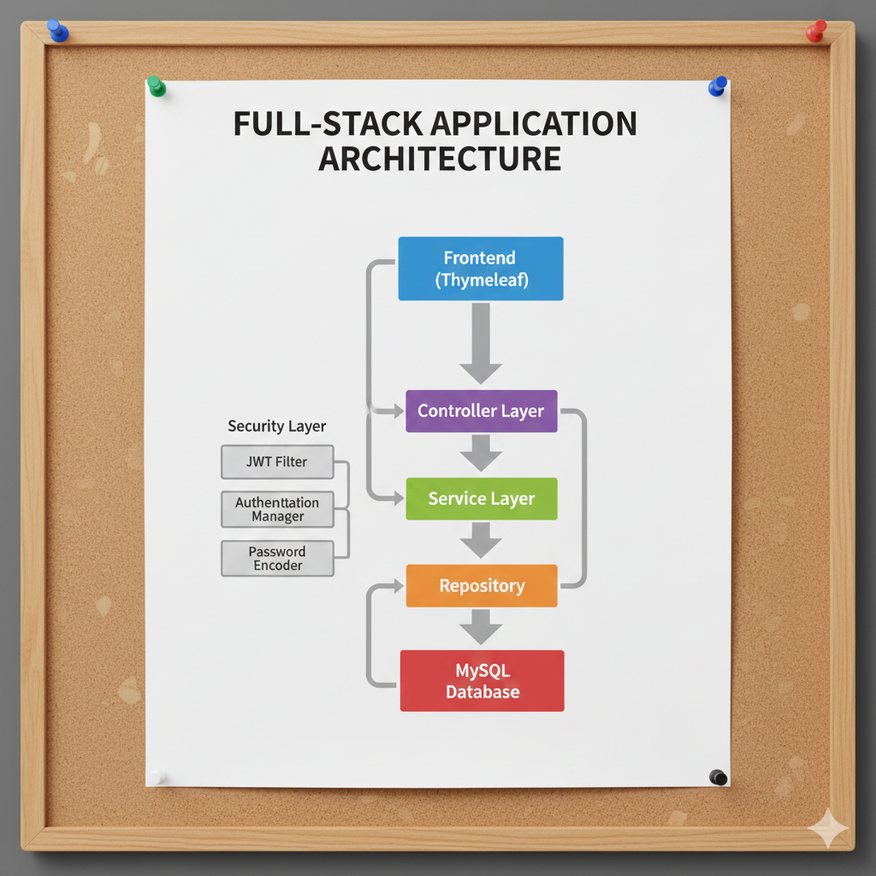
System Architecture

Slide 13
Technology stack
•Frontend:
•Technology: html, css, Thymeleaf, Bootstrap
•Purpose: User interface for interacting with the system
•Features:User authentication, product management, stock tracking, report viewing, and alert management.
•Backend:
•Technology: Java (Spring Boot) ,Hibernate
•Database: MySQL
•Purpose: Handles data storage, business logic, and API endpoints.
•API: RESTful API for communication between the frontend and backend.
•Tools :
•intellij IDE
•postman
•vs code
•MySQL Workbench

Slide 14
Module 1-Authentication
•Process:
•User enters credentials (username/password).
•AUTH Controller receives the request.
•AUTH Controller calls AUTH Service to validate the credentials.
•AUTH Service calls AUTH Repository to retrieve user data from the User Database.
•AUTH Repository queries the User Database.
•AUTH Service compares the entered credentials with the data from the database.
•If valid, AUTH Service generates a token (e.g., JWT).
•AUTH Controller returns the token to the user.
•Classes:
•AUTH Controller: Handles authentication-related HTTP requests.
•AUTH Service: Implements the authentication logic.
•AUTH Repository: Interacts with the User Database.
•User: Represents a user in the system (database entity).
•Uses:
•Secure user access to the system.
•Role-based access control (RBAC).
•Protection of sensitive data.

Slide 15
Dependencies used in our project
Spring Web
Spring Data JPA
MySQL
Spring Security
JWT
Thymeleaf
Lombok
ModelMapper
Spring Mail

Slide 16
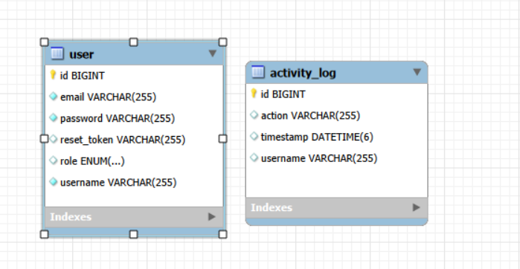
Database Schema
User and Acticity Logs table:

Slide 17
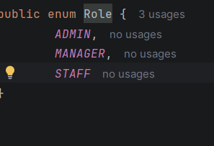
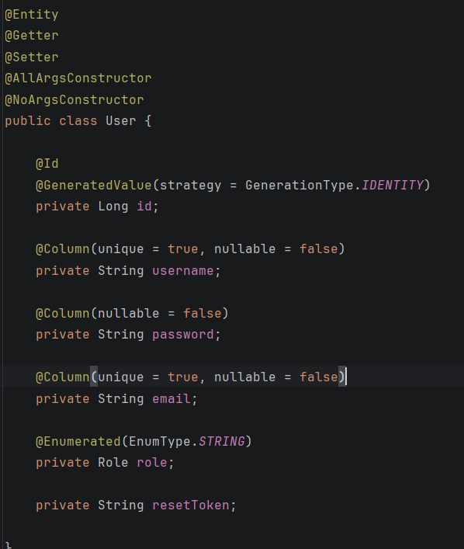
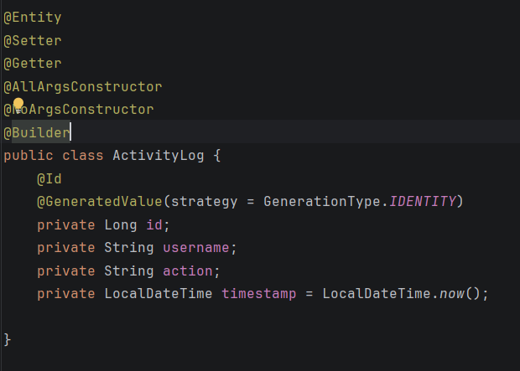
code snippets of classes
1.Entity layer

Slide 18
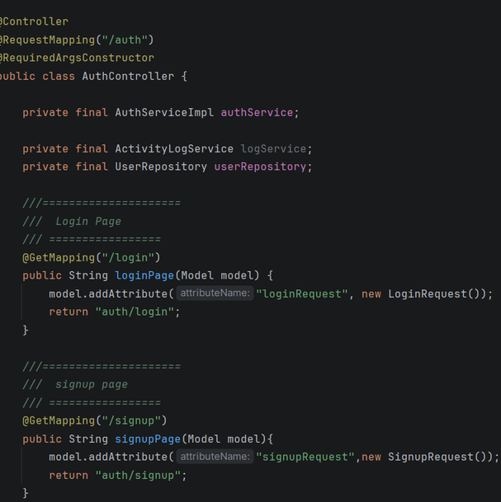
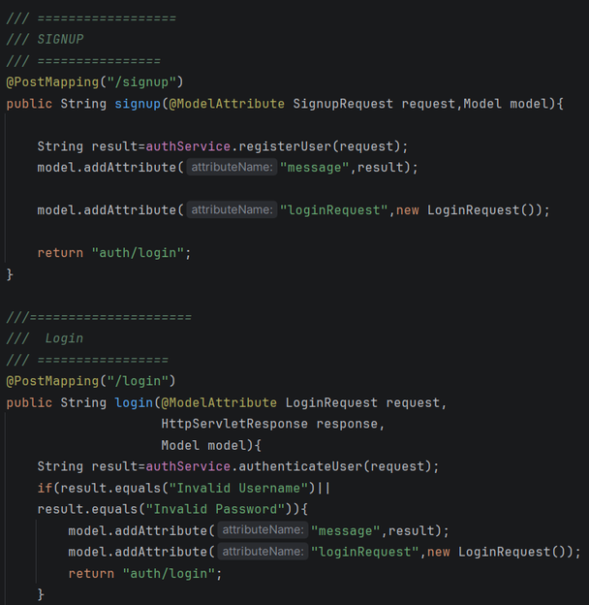
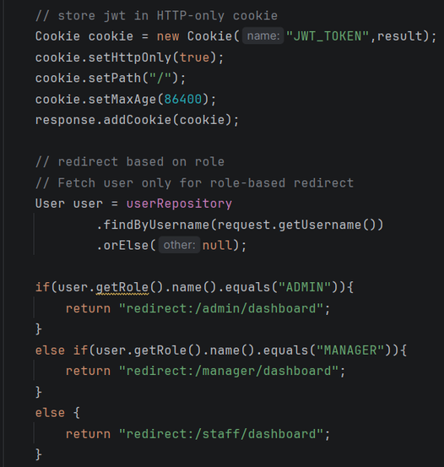
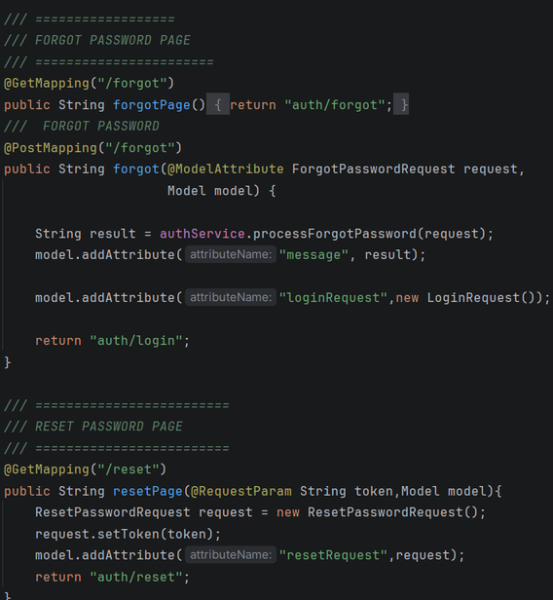
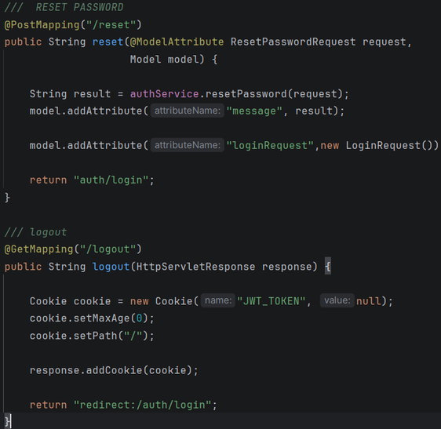
2.Controller

Slide 19
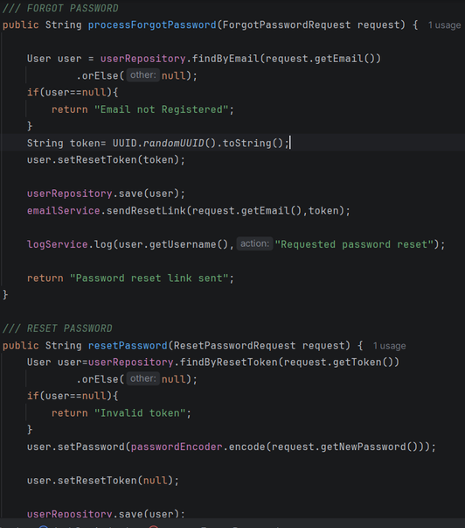
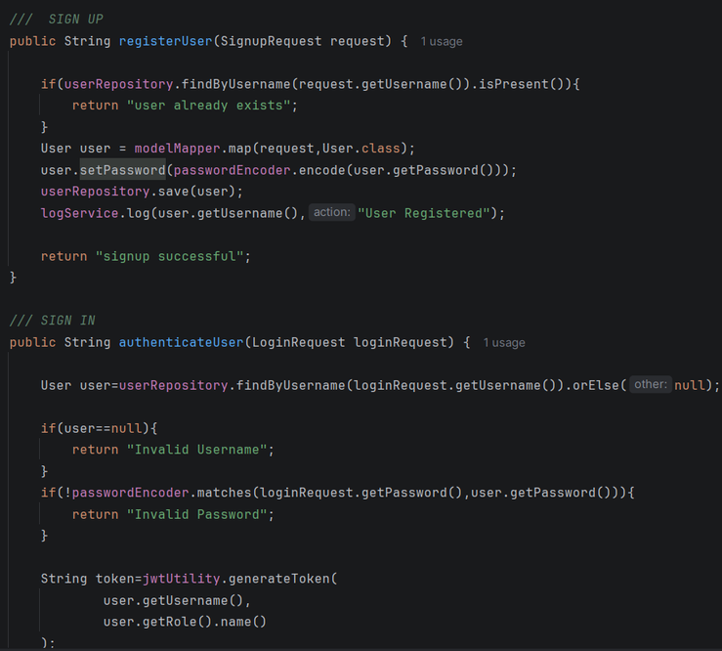
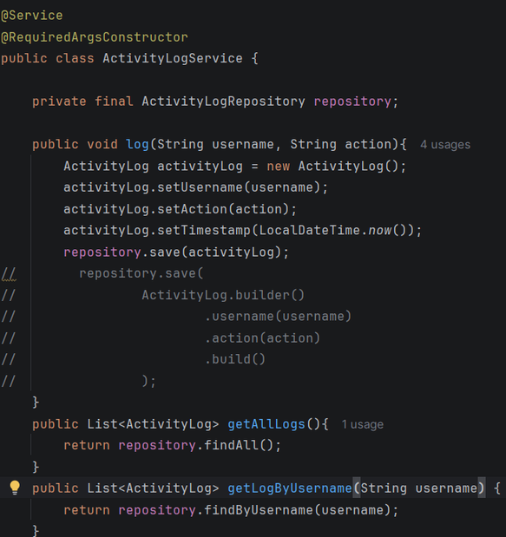
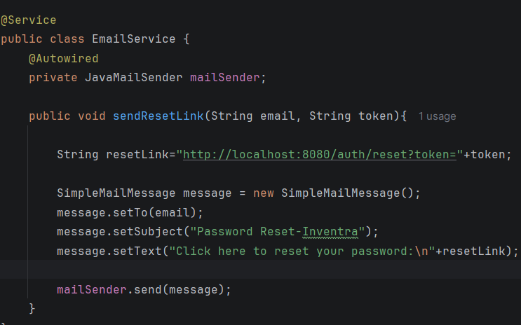
3.Service

Slide 20
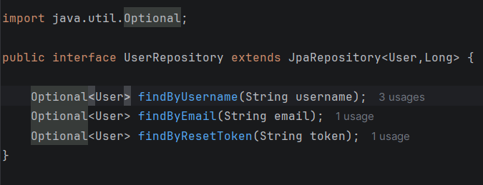
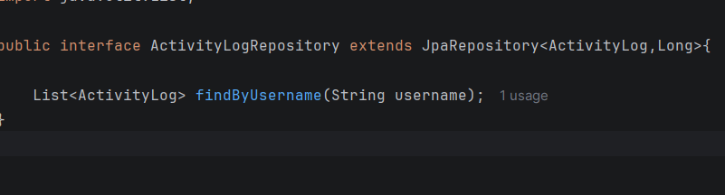
4.Repository

Slide 21
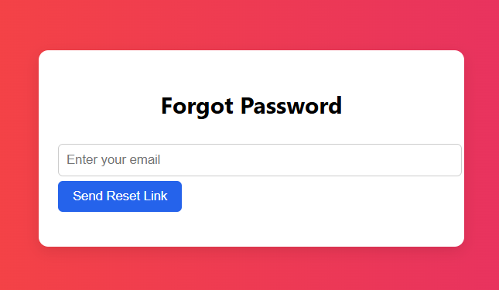
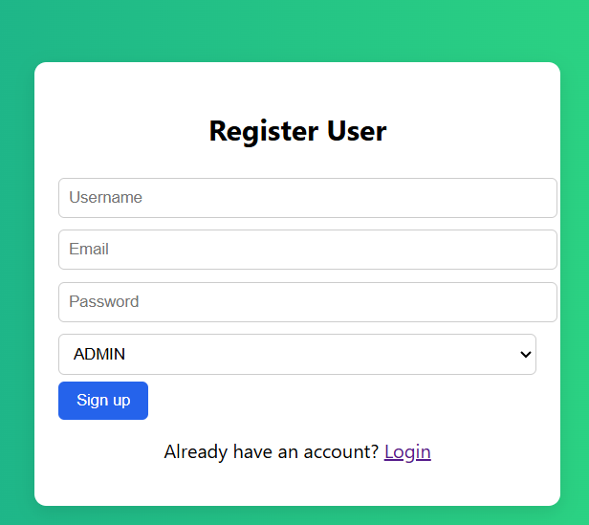
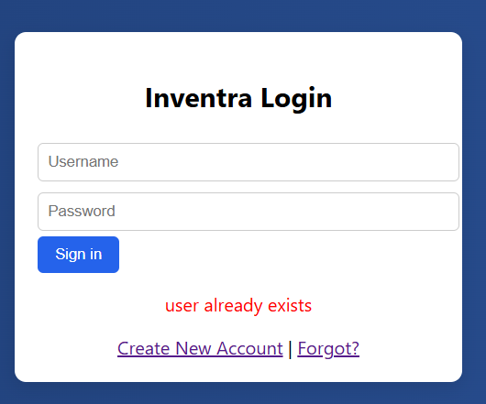
ScreenShots:

Slide 22
Conclusion:
The Authentication Module is a very important part of the system because it makes sure that only the correct users can access the application. It allows users to register safely by protecting their passwords before saving them in the database. During login, the system checks the username and password and then gives a secure token for safe access. If a user forgets the password, the system helps reset it through email in a secure way without showing any sensitive information. The module is designed in a clear and organized structure, which makes it easy to manage and maintain. Overall, it provides strong security and forms the base for a safe and reliable application.
22

Slide 23

THANK YOU!
Presented by : Sasank Ega
23

